Slide 1

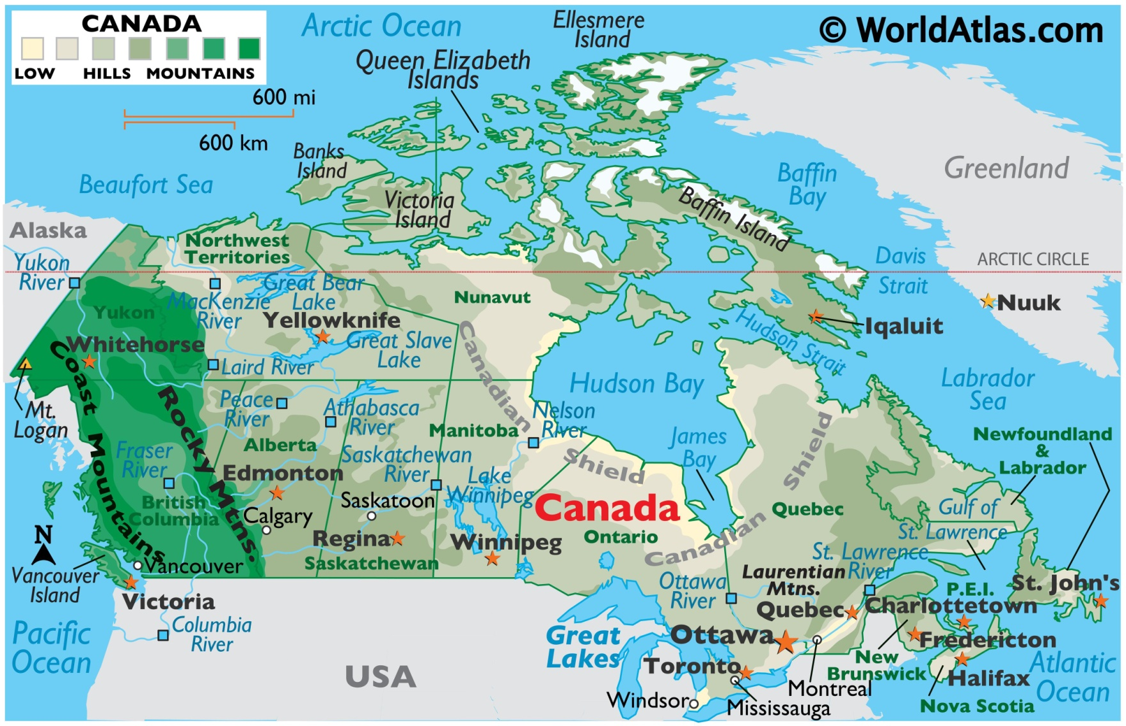
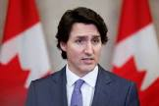
Canada
April 17-21
Prime Minister

Slide 2
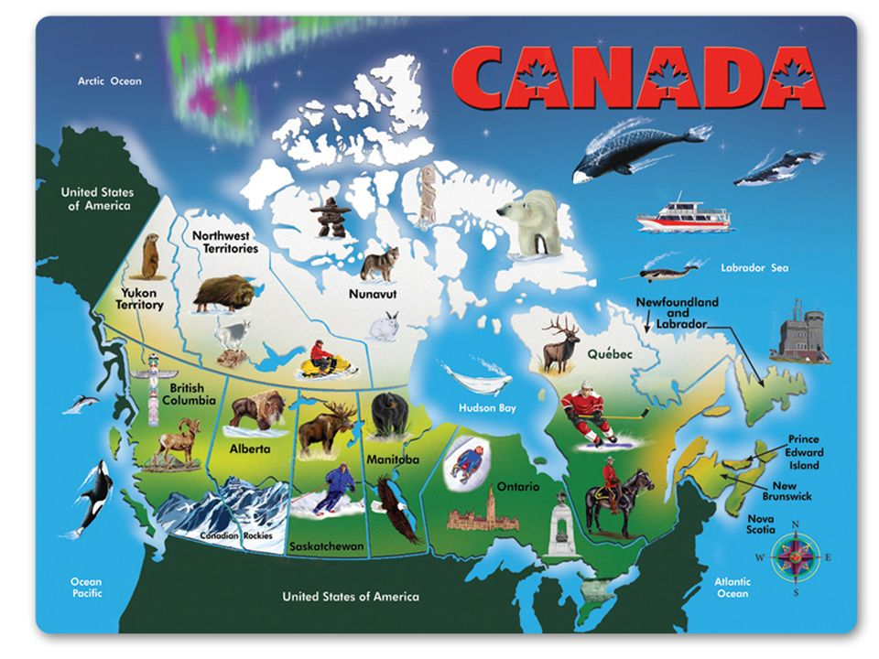

Slide 3
SS6CG2 Explain citizen participation in the Canadian government. a. Explain the role of citizens in choosing the leader of Canada (parliamentary democracy)
SS6H2 Describe Quebec’s independence movement.

Slide 4
SS6G4 Locate selected features of Canada.
Locate on a world and regional political-physical map: the St. Lawrence River, Hudson Bay, Atlantic Ocean, Pacific Ocean, the Great Lakes, Canadian Shield, and Rocky Mountains.
b. Locate on a world and regional political-physical map Canada and the province of Quebec.
SS6G5 Explain the impact of location, climate, distribution of natural resources, and population distribution on Canada.
a. Describe how Canada’s location, climate, and natural resources impact trade and affect where people live.
SS6G6 Explain the impact of environmental issues in Canada.
a. Explain the causes and effects of pollution and acid rain in Canada to include the Great Lakes.
b. Explain the causes and effects of the extraction of natural resources on the Canadian Shield (e.g., mining and logging).

Slide 5
 | Monday 17 | Tuesday 18 | Wednesday 19 | Thursday 20 | Friday 21
Focus Standard(s) | SS6CG2 | SS6CG2 | SS6CG2 | SS6CG2 | SS6CG2
Learning Target(s) | Canada Government | Canada Government | Canada Government | Canada Government | Canada Government
Opening | Video: Canada’s Government | Video: Branches of Government | Video: Royal Canadian Police | Video: Canada’s Government | Video: Canada’s Government
Work Session | Select Class Roles for Gov. Representation Textbook Chapter 10 Pages 251-254 Canada Project | Textbook Chapter 10 Pages 251-254 Canada Project | Textbook Chapter 10 Pages 251-254 Canada Project | Textbook Chapter 10 Pages 251-254 Canada Project | Textbook Chapter 10 Pages 251-254 Canada Project
Closing | TOD | Think-Pair-Share | Class Discussion | Think-Pair-Share
Minor Assignments Due
Major Assignments Due |  |  | GA Milestones Testing | GA Milestones Testing
Current Relearning & Reassessment Assignments (with due dates) |  | Continue to have students study and complete any missing graded assignments
Vocabulary
Upcoming Major Assignments

Slide 6

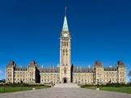
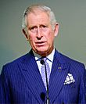

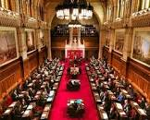

Canada’s democratic government
To live together in a community or a country we have to have rules.
For rules to be followed they need to be made into laws. So, how do we decide what rules and laws we need?
In Canada people have a say in what rules and laws are made. This is because in Canada we are a democracy. That means that our government makes decisions based on what most people say is important.
There are too many people to have everyone come together in one place and decide on rules and laws. So instead people elect representatives, or other people to speak for them. Special elections are held for voting. The elected representatives then make the laws and decisions for everyone. They govern on behalf of the people.
There are many things that need rules and laws so a system is created to manage this. This system is called government.

Slide 7
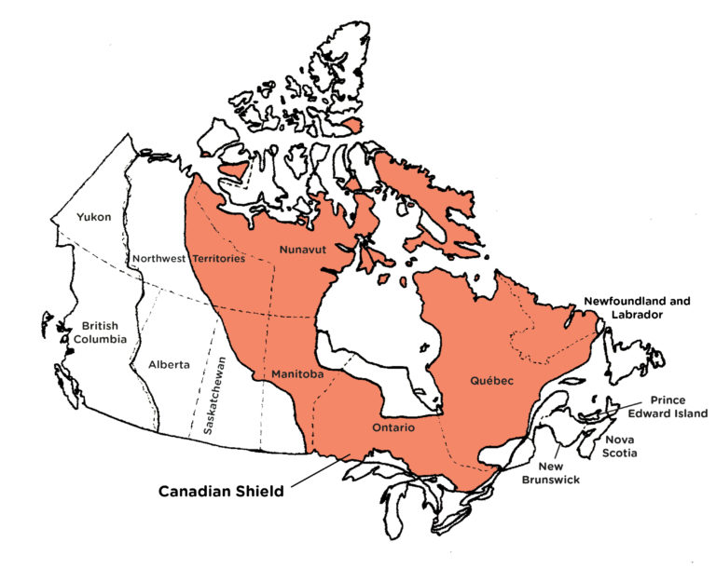
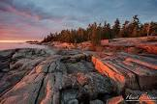

The Canadian Shield
Video: Canadian Shield
Various minerals and precious stones have been mined or continue to be mined on the Shield, including gold, silver, copper, zinc, nickel, iron, uranium and diamonds. The first modern hard-rock mine in the Canadian Shield, near Madoc, Ontario, opened in 1866 after gold was found there.

Slide 8


Slide 9
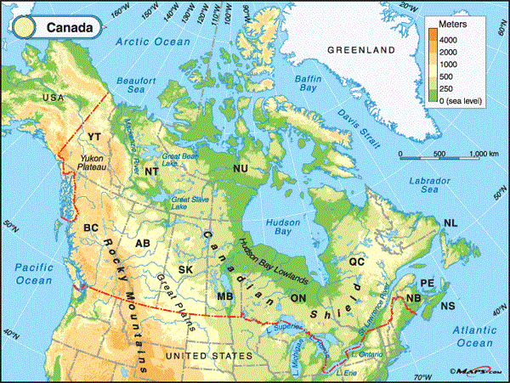
Locate on a world and regional political-physical map: the St. Lawrence River, Hudson Bay, Atlantic Ocean, Pacific Ocean, the Great Lakes, Canadian Shield, and Rocky Mountains.

Slide 10
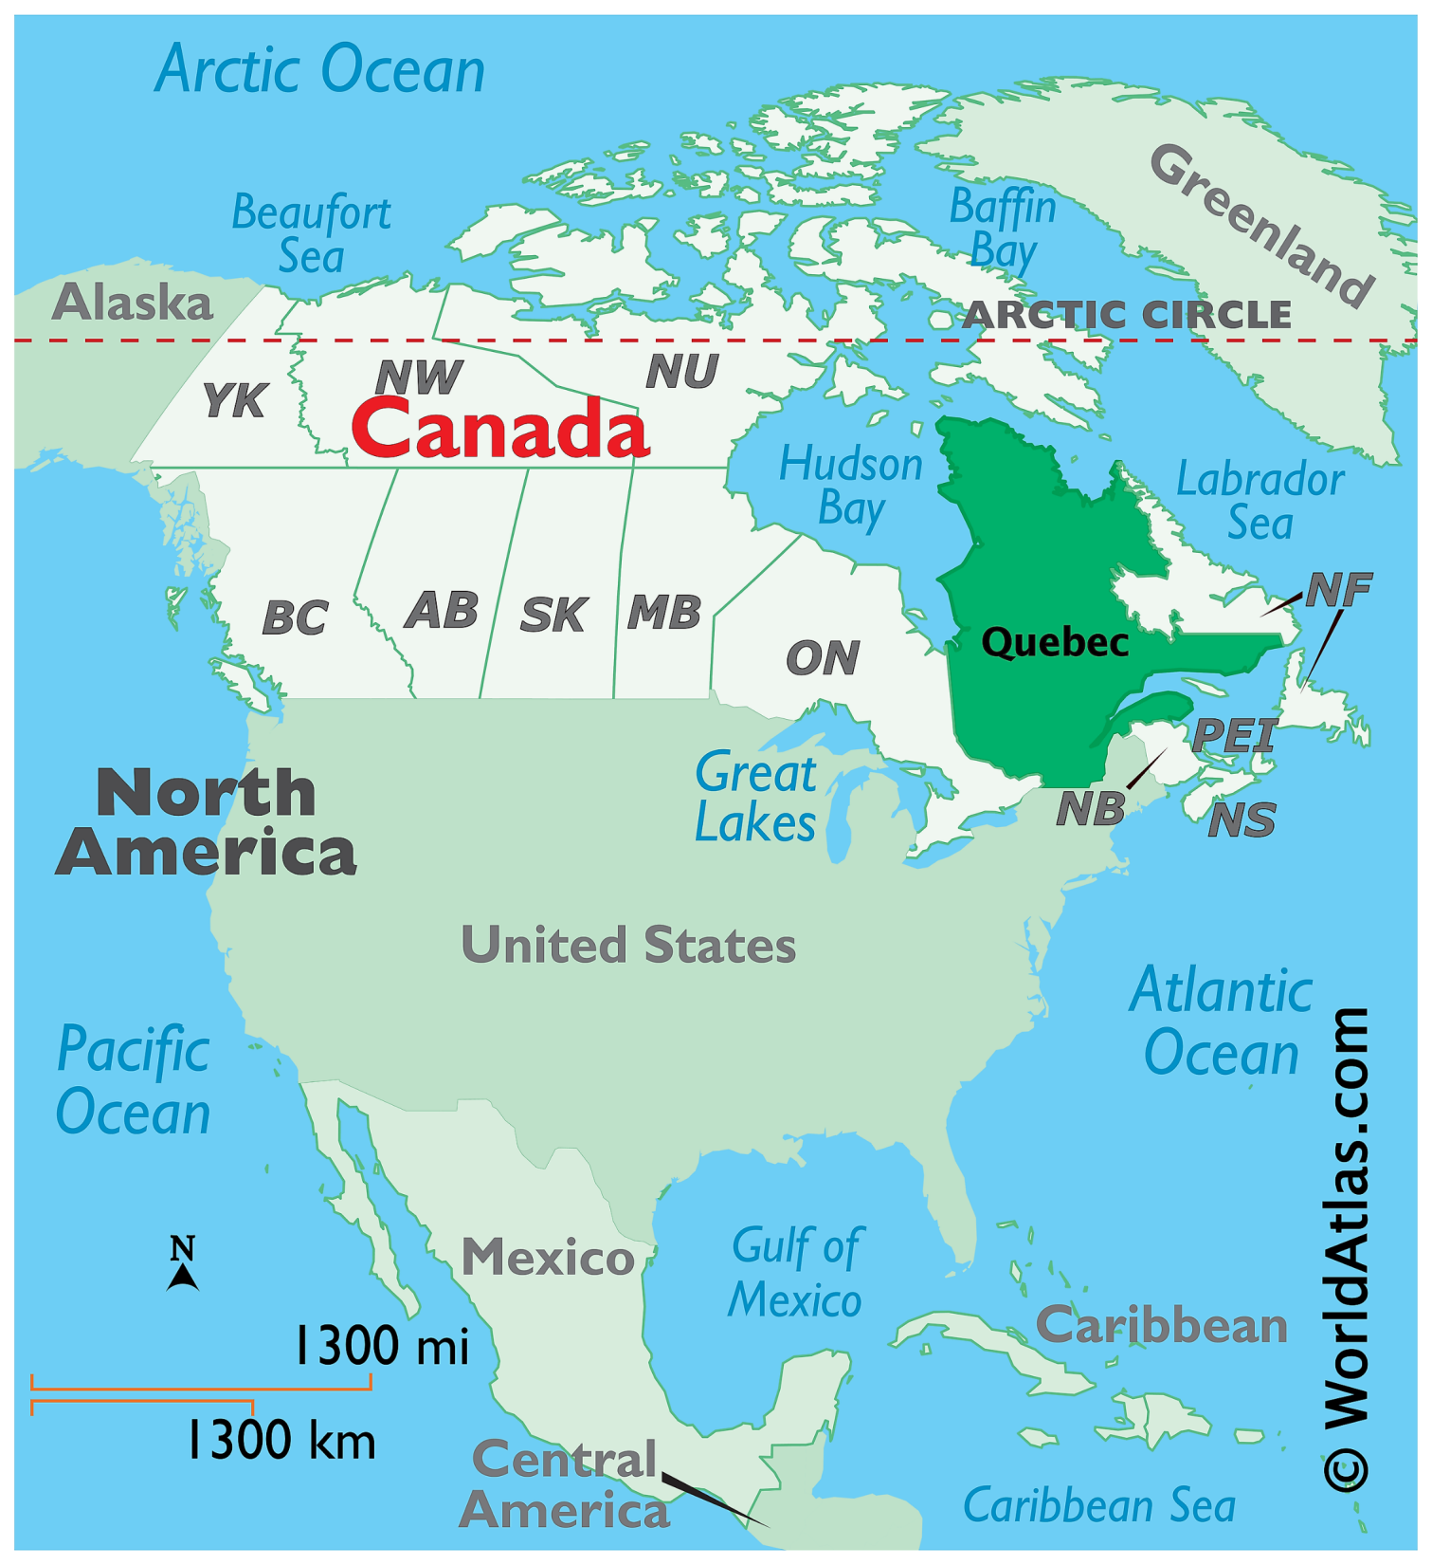
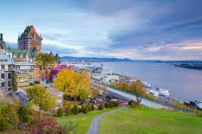
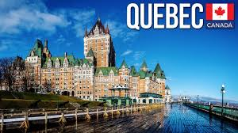

Slide 11
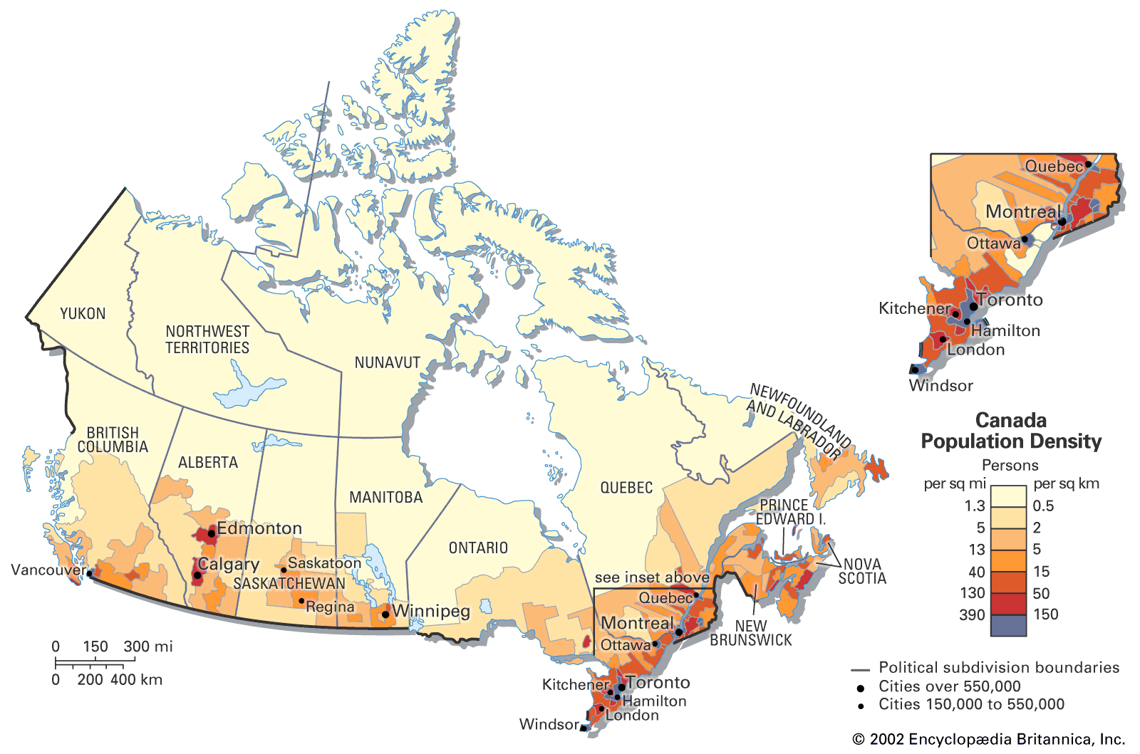
Population:
Where people located

Slide 12
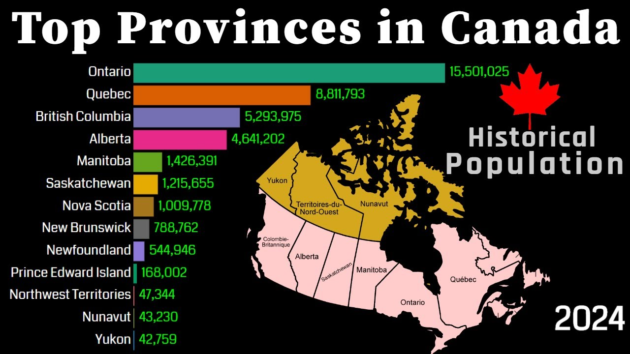

Slide 13
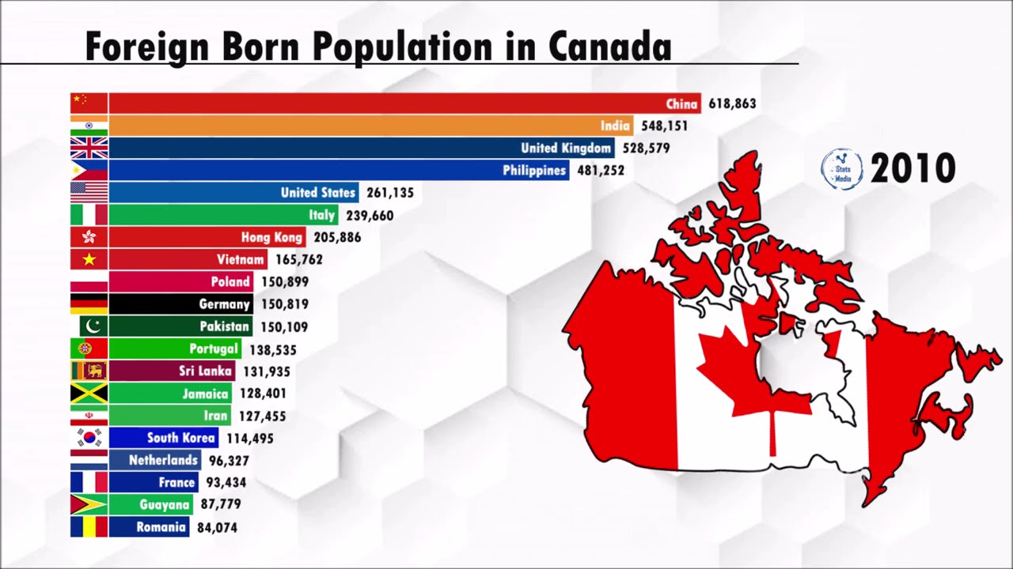

Slide 14
